Slide 1



Incogni vs Pentester.com
Which Privacy Protection Tool is Right for You? A Friendly Comparison for Small Business Owners, High-Net-Worth Individuals & Solo Consultants
Questions? Reach out to bill@thetechcoaches.com

Slide 2

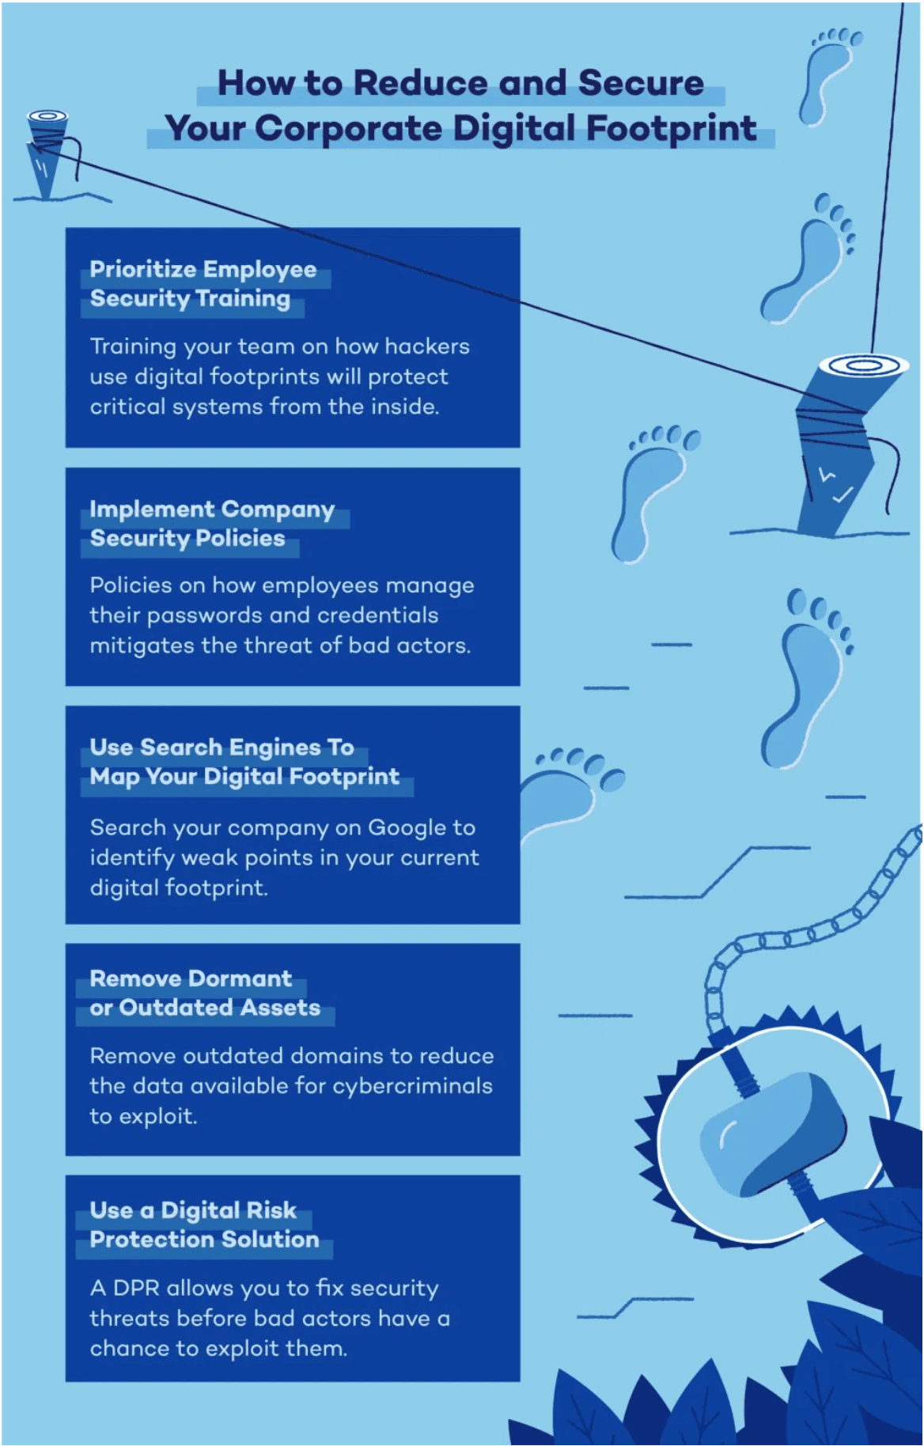




Why This Matters
Your Digital Footprint is Bigger Than You Think
420+ Data Brokers are actively collecting, aggregating, and selling your personal information right now.
Prime Targets: Small business owners, executives, and consultants are high-value targets for identity theft.
Data = Money: Your personal data is a commodity sold to marketers and potentially cybercriminals.
High Cost of Breaches: One data breach can cost thousands in recovery time, legal fees, and reputation damage.

Slide 3




What's the Difference?
Two Different Approaches to Protecting Your Privacy
Incogni
Pentester.com
Focuses on removing your personal information from data broker databases to stop spam and reduce exposure.
Focuses on scanning your website and digital assets to find security vulnerabilities before hackers do.
Focus: Security Scanning
Focus: Privacy Protection
Key Insight: They solve different problems — think of it as Privacy vs. Security.

Slide 4





The Data Privacy Expert
Incogni: Remove Your Data From 420+ Data Brokers
Incogni automatically scans and removes your personal information from data broker sites, reducing spam calls, emails, and online exposure.
Automated Removal Requests
Requests are sent regularly to ensure your data stays off these lists permanently.
Progress Tracking
Watch the removal process in real-time through your personal dashboard.
Family Protection
420+
Options to protect up to 5 family members under one account.
Data Broker Sites Covered with Recurring Removals
Starting at $7.99/mo (billed annually)
30-Day Money-Back Guarantee

Slide 5








Pricing Plans
Choose What Works for You
Save 50% Annually
Standard
Unlimited
Family
Family Unlimited
Protect
$7.99
$14.99
$15.99
$22.99
$20.74
per month
per month
per month
per month
per month
420+ Data Brokers
Everything in Standard
Up to 5 Members
Up to 5 Members
Data Removal + ID Theft Protection
Automated Removal
420+ Data Brokers
2,000+ Additional Sites
2,000+ Additional Sites
Dark Web Monitoring
Progress Dashboard
Family Management
Custom Removals
$1M Insurance
Custom Removal Requests
Live Phone Support

Slide 6

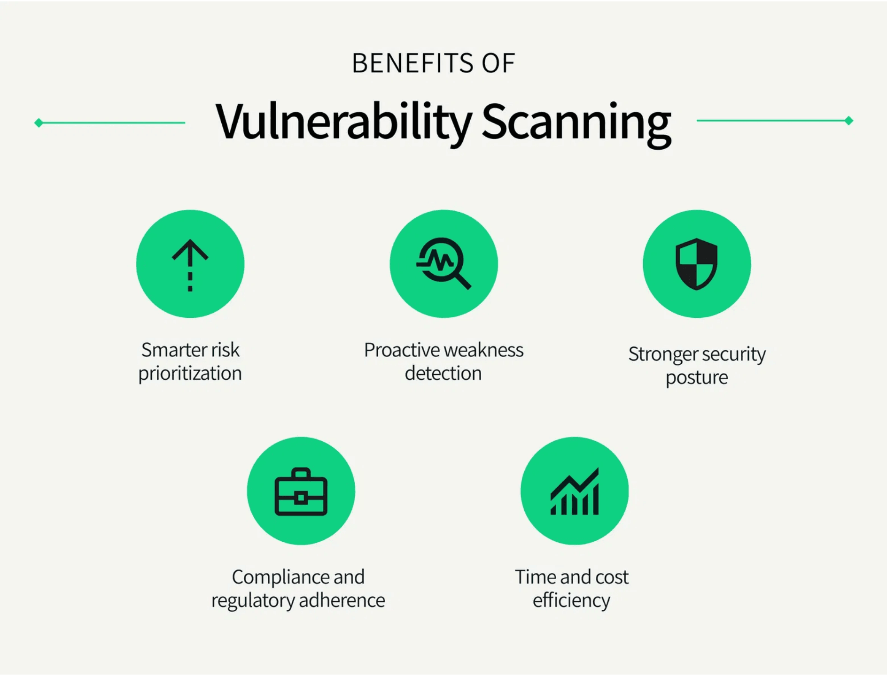


The Security Scanner
Pentester.com: Find Vulnerabilities Before Attackers Do
Scans your website and digital footprint for security vulnerabilities and data breaches using AI-powered technology and red team expertise.
9,000+ to 39,000+ security tests per scan
Dark Web Monitoring of 140+ billion records
Industry-Specific Reports (Healthcare, Legal, Finance)
Free to Try with no credit card required
Best For
Small business owners and professionals who need ongoing security monitoring and compliance assurance.

Slide 7





Pricing Plans
Pentester.com Plans: Scaled for Your Needs
Personal
Small Business
Pentester Elite
$19
$49
$899
per month
per month
per month
Individual data removal
Website security testing
Full penetration testing
Basic security scanning
Employee & executive data removal
Annual assessments
Dark web monitoring
Dedicated support
Monthly manual testing
AI-powered automation
Industry-specific reports
Value Add: All plans include AI-powered website testing and Red Team expertise to find vulnerabilities before attackers do.

Slide 8









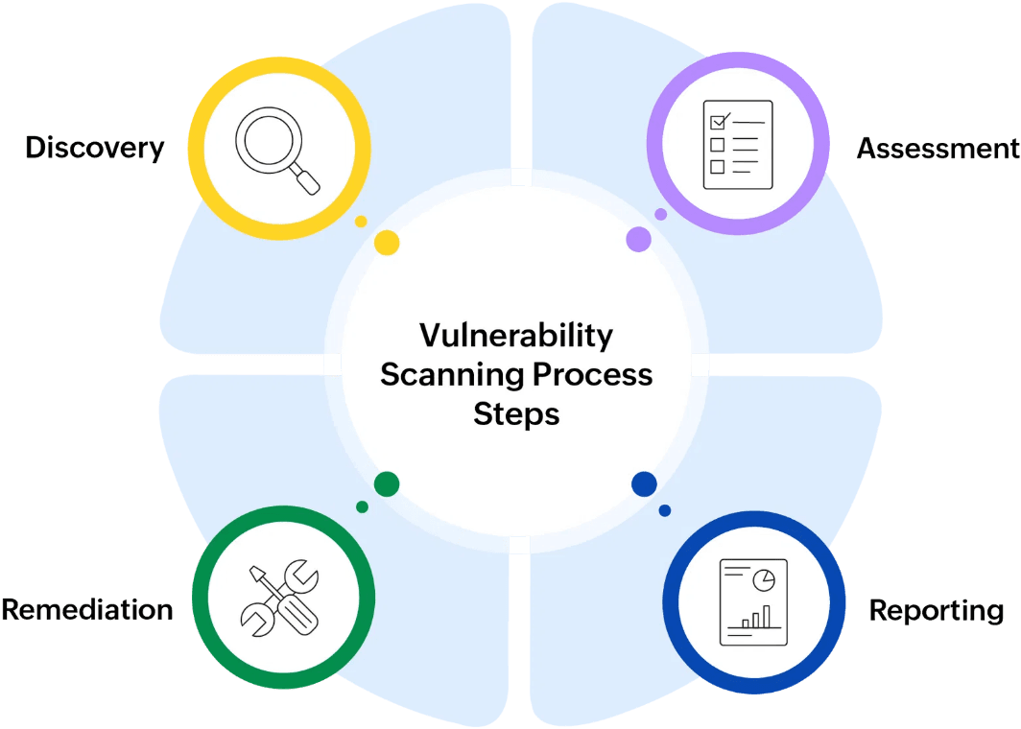
Comparison
Quick Comparison: What Each Tool Does Best
Feature
Incogni
Pentester.com
Data Broker Removal
Yes (420+ sites)
Yes (Included)
Website Security
No
Yes (9k-39k tests)
Dark Web Monitoring
Yes (Higher tiers)
Yes (All plans)
AI Automation
Yes
Yes
Live Phone Support
Yes (Higher tiers)
Yes (Small Biz+)
Free Trial
30-day money-back
Free scan (no card)
Privacy Protection
Security Scanning
Best For
$7.99/month
$19/month
Starting Price

Slide 9


Target Audience
Incogni is Perfect If You Want to...
Reduce spam calls and emails significantly
Remove personal info from public databases
Protect your family's privacy from strangers
Get peace of mind about your digital footprint
Prefer a simple, automated "set and forget" solution
Ideal Users
Privacy-conscious individuals, busy professionals, and families.

Slide 10



Ideal Use Cases
Pentester.com is Perfect If You Want to...
Scan your website for vulnerabilities automatically
Ensure compliance with industry standards (HIPAA, etc.)
Monitor for data breaches in real-time
Get detailed security reports for your team
Protect your business from cyber attacks
Ideal Users
Small business owners, healthcare practices, financial services, and anyone running a business website.

Slide 11

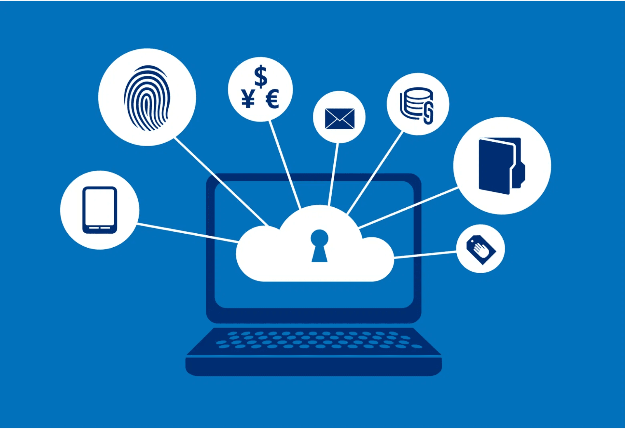



Comprehensive Protection
The Best Solution? Use Both Together!
Incogni
Handles your personal data privacy by removing you from data broker lists.
Pentester.com
Handles your business security by scanning for vulnerabilities.
Complete Peace of Mind
You are covered on both fronts: Personal Privacy + Business Security.
Combined starting at only ~$26.99/month

Slide 12

Problem Solving
Which Tool Solves Your Problem?
Scenario 1
The Solution
"I'm getting way too many spam calls, emails, and I'm worried about my info being online."
Incogni
Removes your data from brokers
Scenario 2
The Solution
"I run a business website and I'm terrified of hackers finding a vulnerability."
Pentester.com
Scans for security risks
Scenario 3
The Solution
"I want complete peace of mind for both my personal privacy and my business security."
Use Both
Complete 360° protection

Slide 13







Ready to Start?
Start Protecting Your Privacy Today
1. Sign Up
2. Authorize
3. Automate
4. Monitor
Create your account in minutes with just your name and email.
Grant Incogni the right to send removal requests on your behalf.
Incogni automatically contacts 420+ data brokers for you.
Watch your personal data disappear from the web via your dashboard.
Get Started with Incogni
Risk-Free 30-Day Money-Back Guarantee

Slide 14





Take Action
Start Scanning Your Security Today
Ready to secure your business?
Fast Results: See critical risks in under 30 seconds.
Special Offer
Get a Free 1-Month Trial
Risk-Free: Free scan with no credit card required.
Contact me to claim this offer:
Ongoing Protection: Get continuous monitoring and detailed reports.
bill@thetechcoaches.com
Expert Support: Dedicated team available to help you secure your business.

Slide 15


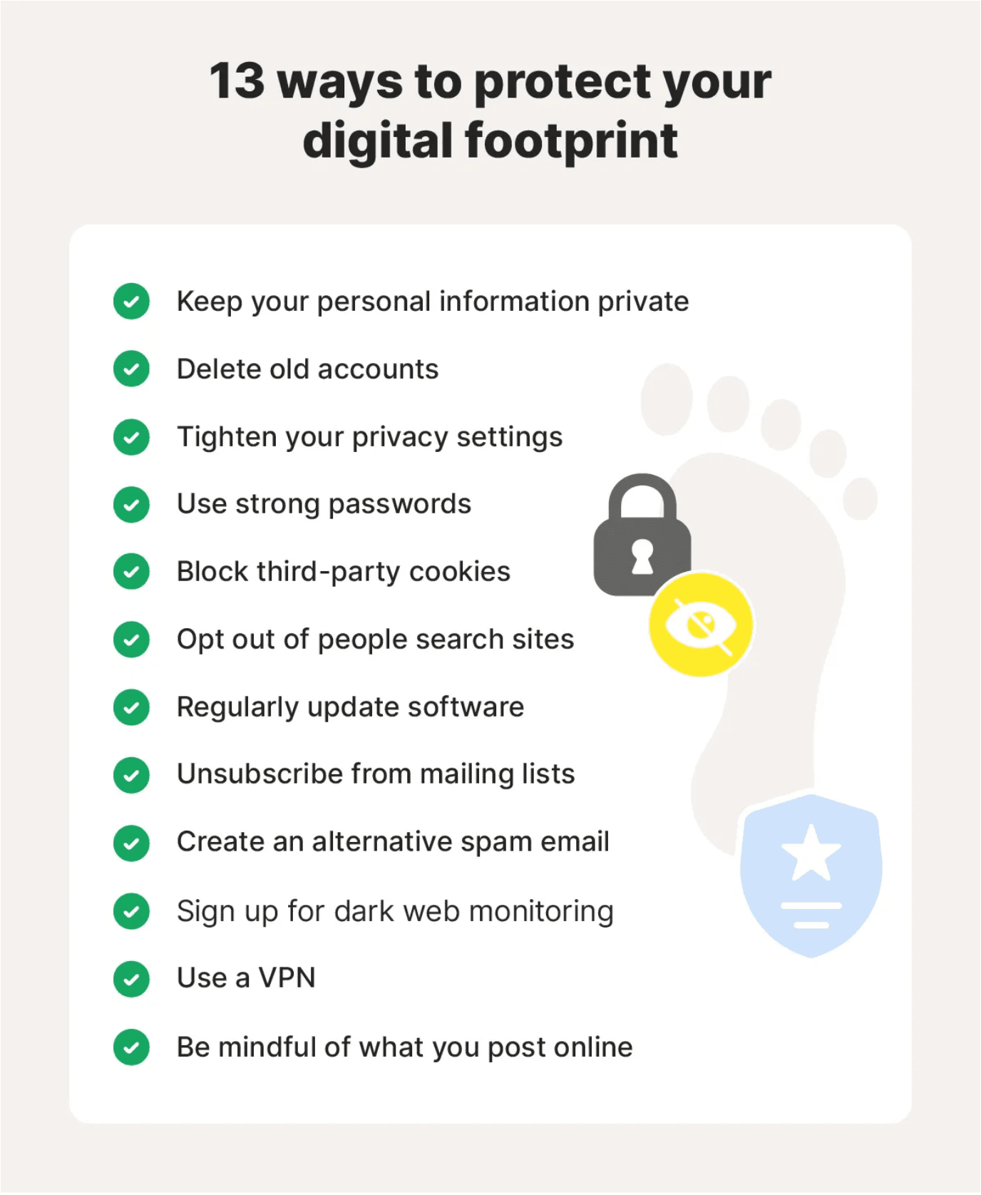
Let's Connect
Have Questions? I'm Here to Help!
Navigating privacy and security can be complex. Whether you're a solo consultant or running a small business, I'm happy to help you choose the right tools.
Email Me
bill@thetechcoaches.com
Visit Website
thetechcoaches.com

